Slide 1


BUSINESS BLUEPRINT

Slide 2
BACKGROUND
Background of MHS and MHS TP

Slide 3
MHS Background
The core application for the stores
Being used in more then 300 stores today and approximately 500 stores in 2020
Global system used in all RIIG stores and one ROIG store
90.000+ users
A vital part of the eCommerce platform
Has successfully supported IKEA’s growth since 1987
MHS is a unique system supporting IKEA’s unique way of doing business.

Slide 4

MHS History
Phasing out a large legacy system is not an easy task. On a regular basis IKEA has performed investigations that looks into the future for the MHS system, investigating technical and functional limitations as well as the alignment with the enterprise architecture plans. Examples of earlier initiatives:
1998, Business Driven Supply (BDS): Replace MHS with standard package as part of an overall SAP strategy
2000, New IT Foundation (NITF): Replace MHS with new Store Warehouse Management standard package in combination with new NITF based SOA development for selected parts, did not succeed. By end of 2015 we will have replaced almost all of Selling functionality with iSell (still dependent on MHS) which was an outcome of this initiative
2005, Store Retail Platform/New Retail Platform/Oracle Application Assessment: Replace MHS with best of breed or single standard package solution.
2000 – 2007, P3: M3/P3 SGF projects attempted to replace the store logistics parts of MHS with the Red Prairie Dispatcher standard package, but the project was closed down after an unsuccessful pilot.
2010, Store Replenishment Planning: Replace the forecast and safety stock parts of MHS (SRS).
Store Replenishment Planning
Business driven supply
New IT Foundation
New Retail Platform
SGF Dispatcher
Replace GADD for MHS with Cognos
MHS Pilot in Älmhult
POS and stock figures
Customer Order Pilot
VAX to Alpha project
MHS Common, 1 version of MHS
SGF Pilot
SLM Pilot
PinS pilot
MHS Project started
IKEA Marketing unit split. MHS split into 3 versions
WinMHS Pilot (Russia)
North America project 2 versions of MHS
Returns Pilot
SGF Mobile Pilot
CPS Pilot
MHS TP Starts
Y2K conversion
Alpha to Itanium project
SRS Pilot
1986 1987 1988 1989 1990 1991 1992 1993 1994 1995 1996 1997 1998 1999 2000 2001 2002 2003 2004 2005 2006 2007 2008 2009 2010 2011 2012 2013 2014

Slide 5

Business Critical for IKEA
”A business critical decision has been made to transfer MHS functionality to different target applications.”
MHS has served IKEA very well for many years, but as the technical platform ceases to exist we have no choice but to start the MHS Transformation Programme now.
This transformation will support IKEA’s business development
It will enable IKEA to keep the business running, continue to grow 2020 and beyond, speed up the development of high performing tools for high performing co-workers and have flexibility to grasp new business opportunities.
It will be a long, complex and demanding journey
It will require commitment and concentration from managers, clear decision making when necessary, strong collaboration cross functionally at times and a strong focus on the purpose and goals of the programme.
Martin Hansson,
Group Retail Manager and sponsor of the MHS TP.

Slide 6
CONTEXT
Context that sets the frames for the blueprint and the programme

Slide 7
Why MHS Transformation Programme?
Secure IKEA business continuity is the main objective and has the highest priority
by eliminating life cycle risks with the current technical platform
by minimising dependencies to IT expertise on outdated technology
by enabling future possibilities with standard solutions
Support IKEA strategic changes in process and organisation to achieve business benefits
by moving functionality, data and information to where it belongs
Support business needs for major changes in system landscape
by removing the legacy complexity of MHS and aligning with TL2020
Notes:
Time delays can lead to that the HP termination of the hardware and the support ends before IKEA manages to transform all functionality in current MHS to new target systems. This could have a fatal impact on IKEA business continuity.

Slide 8
Programme Scope (from PDI)
Scope
The scope for the programme is to transfer out all functionality from MHS to target applications* and to do this within the given time frame.
Limitations
MHS Transformation Programme is driven by risk and the programme will not be responsible for driving any business process development related to the functionality being moved out.
However, some of the projects initiated by MHS TP will support business process development in close cooperation with the process owners to be able to reach the target.
*Target application = In context of the Programme Directive, a target application is defined as an application identified to move out functionality from MHS to, that is aligned with Target Landscape 2020
Notes:
Time delays can lead to that the HP termination of the hardware and the support ends before IKEA manages to transform all functionality in current MHS to new target systems. This could have a fatal impact on IKEA business continuity.

Slide 9
Programme Scope
We will transfer all business functionality currently residing in MHS. The functionality in MHS to transfer out of MHS has been identified and the main functional areas are following
Range and pricing
Forecast & safety stock
Return management
SGF
SLM
Sales order management & reservations
Cash & credit management
Selling
Finance management
Ordering
TAX information & calculation
Reporting
Integration
Local solutions
Infrastructure

Slide 10
The triple contraints
TIME
is our biggest challenge and most critical success factor
Main Principles
MHS has reached end of life and all it’s functionalities will be moved out to: 1. Target solution 2. Legacy solutions
All changes in MHS must go through the MHS Change Advisory Board chaired by MHS Transformation Programme and the EA Principles will be applied
All projects connected to MHS TP must complete a global roll out and remove MHS functionality within MHS TP Roadmap
1
RISK
COST
TIME
3
RESOURCES
QUALITY
SOLUTIONS
SCOPE
2
Notes:
Time delays can lead to that the HP termination of the hardware and the support ends before IKEA manages to transform all functionality in current MHS to new target systems. This could have a fatal impact on IKEA business continuity.

Slide 11
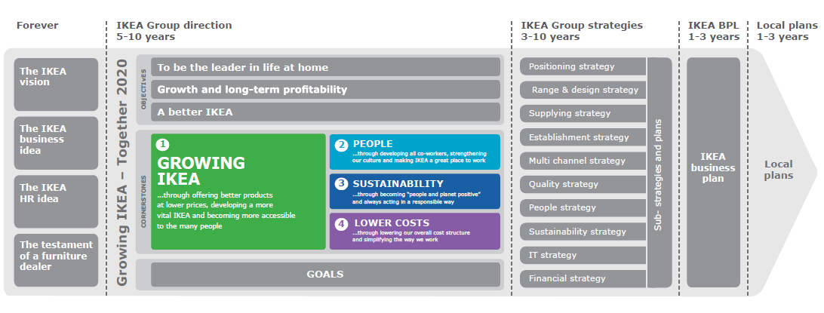
Business Strategies
MHS Transformation Programme is mainly executed to support a Growing IKEA but will support and align to the other strategies as well
Main strategies supported by the initiative

Slide 12
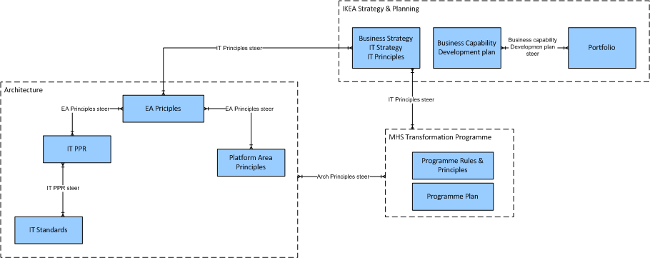
Principles and rules
MHS Transformation programme will apply the principles and strategies of IKEA as well as defining programme specific principles and rules.

Slide 13
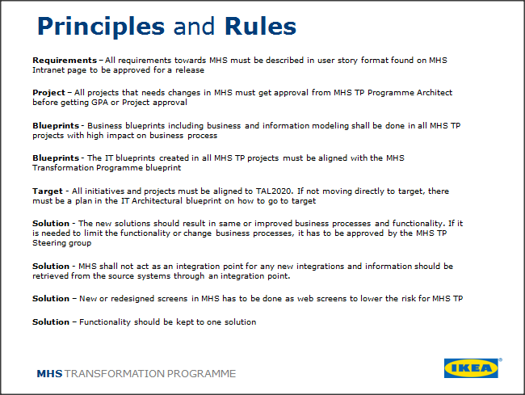
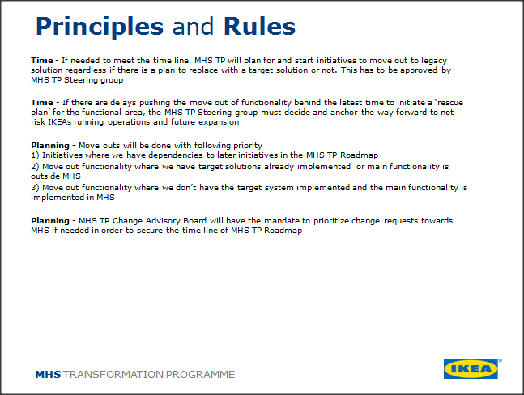
Principles and rules
MHS TP Principles and rules are needed to secure that
we take decisions that leads us in the right direction.
We have defined a number of them
and you can find them here.
We need principles and rules when:
Projects are scoped
Projects change scope
Projects are delayed
Projects fail

Slide 14
Principles and rules
Requirements – All requirements towards MHS must be described in user story format found on MHS Intranet page to be approved for a release
Project – All projects that needs changes in MHS must get approval from MHS TP Programme Architect before getting GPA or Project approval
Blueprints - Business blueprints including business and information modeling shall be done in all MHS TP projects with high impact on business process
Blueprints - The IT blueprints created in all MHS TP projects must be aligned with the MHS Transformation Programme blueprint
Target - All initiatives and projects must be aligned to TAL2020. If not moving directly to target, there must be a plan in the IT Architectural blueprint on how to go to target
Solution - The new solutions should result in same or improved business processes and functionality. If it is needed to limit the functionality or change business processes, it has to be approved by the MHS TP Steering group
Solution - MHS shall not act as an integration point for any new integrations and information should be retrieved from the source systems through an integration point.
Solution – New or redesigned screens in MHS has to be done as web screens to lower the risk for MHS TP
Solution – Functionality should be kept to one solution

Slide 15
Principles and rules
Time - If needed to meet the time line, MHS TP will plan for and start initiatives to move out to legacy solution regardless if there is a plan to replace with a target solution or not. This has to be approved by MHS TP Steering group
Time - If there are delays pushing the move out of functionality behind the latest time to initiate a ‘rescue plan’ for the functional area, the MHS TP Steering group must decide and anchor the way forward to not risk IKEAs running operations and future expansion
Planning - Move outs will be done with following priority 1) Initiatives where we have dependencies to later initiatives in the MHS TP Roadmap
2) Move out functionality where we have target solutions already implemented or main functionality is outside MHS
3) Move out functionality where we don’t have the target system implemented and the main functionality is implemented in MHS
Planning - MHS TP Change Advisory Board will have the mandate to prioritize change requests towards MHS if needed in order to secure the time line of MHS TP Roadmap

Slide 16
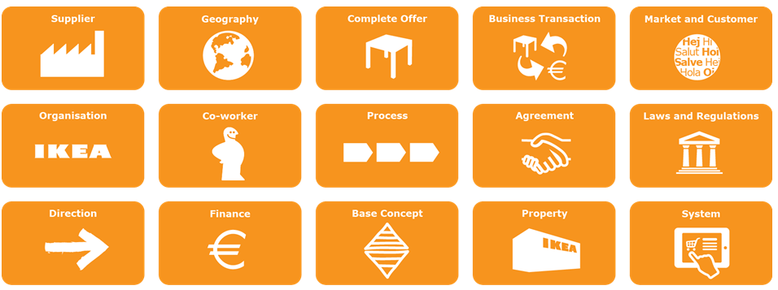
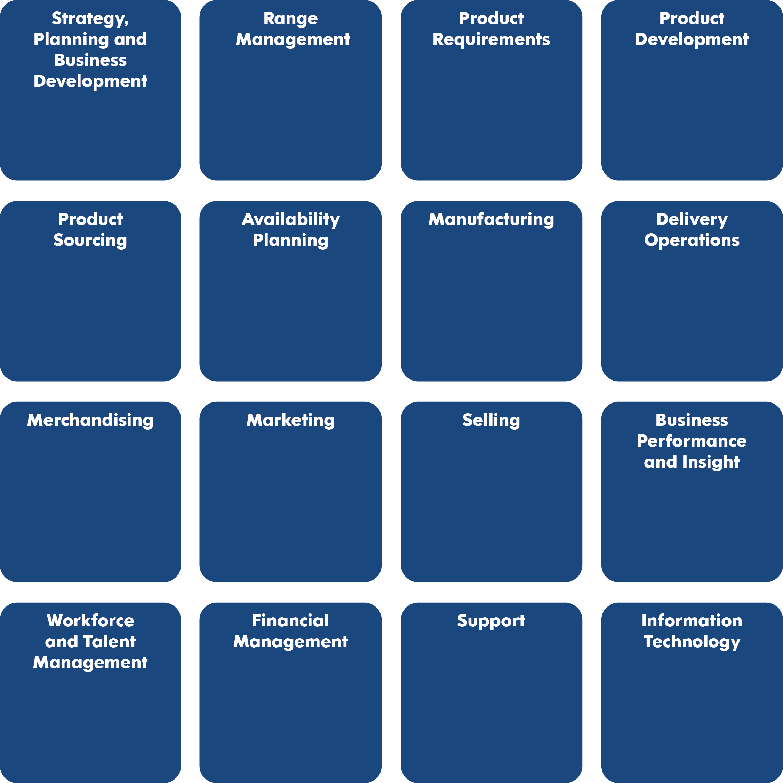
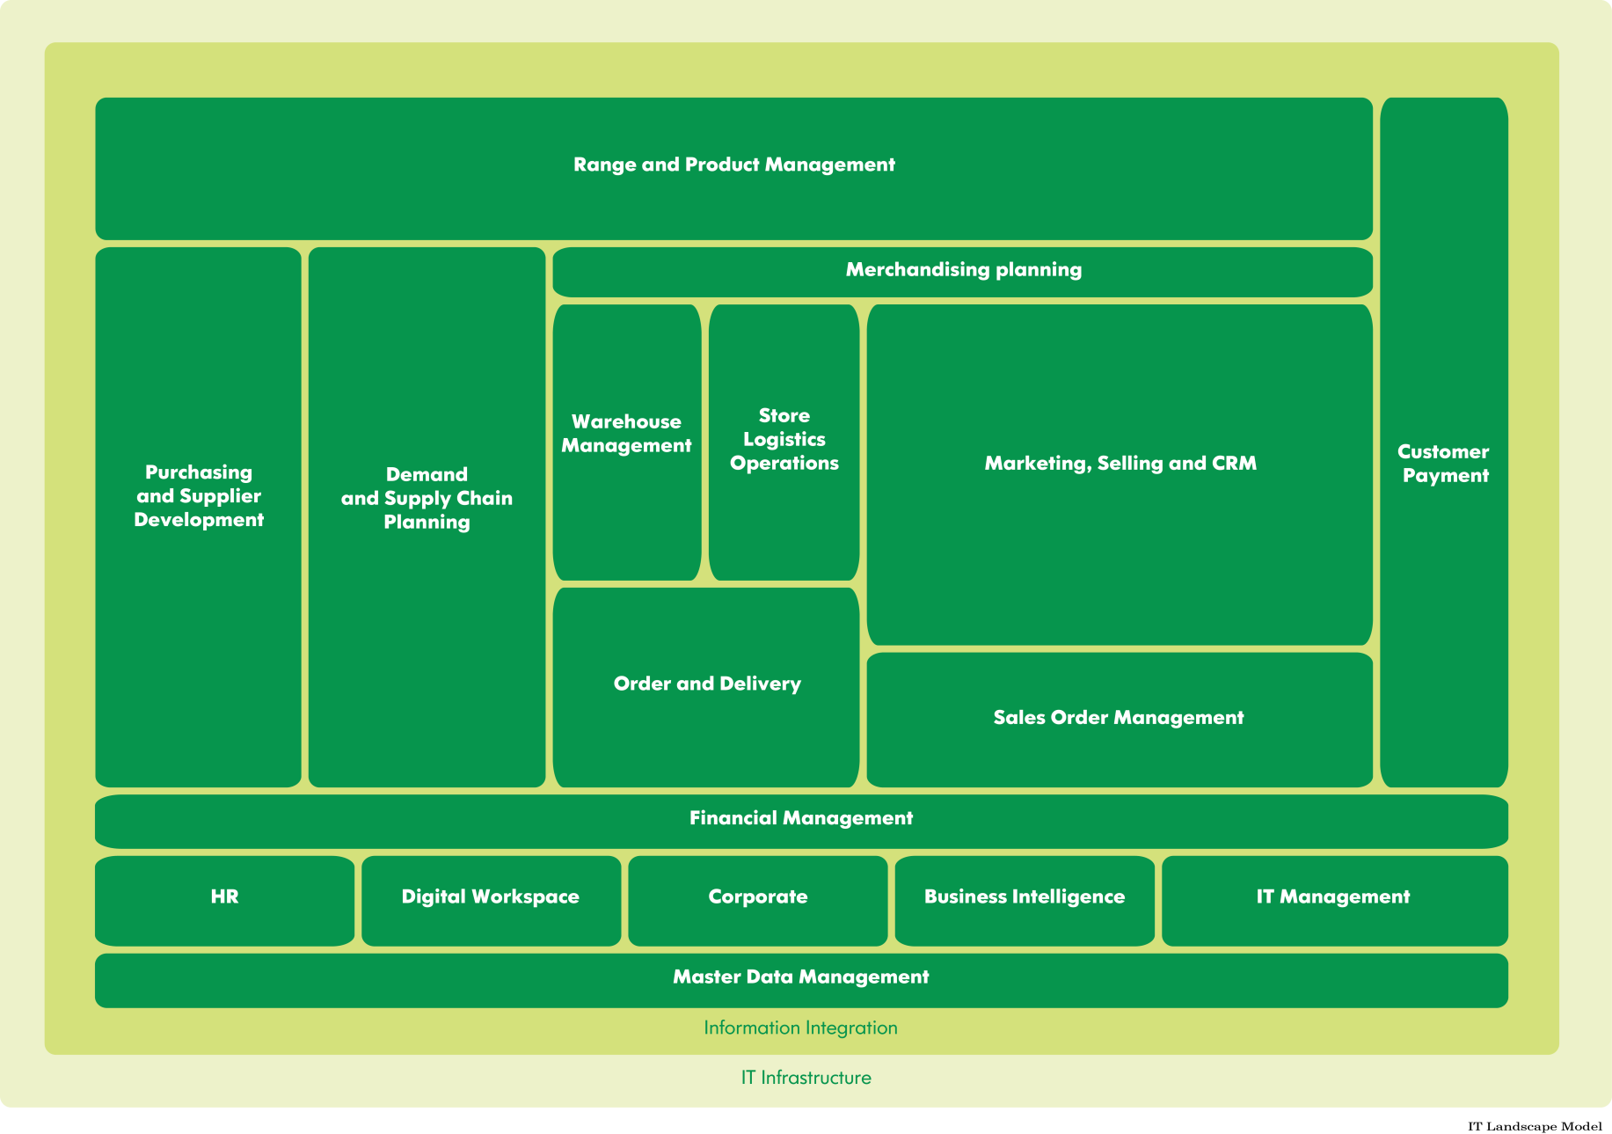
Principles and rules
MHS Transformation programme will align to TL2020 by mapping all move outs to TL2020, using architectural area blueprints, working towards existing forums and organization

Slide 17
BLUEPRINT
Process
Organization
Technology Capabilities
Platform Areas Information

Slide 18
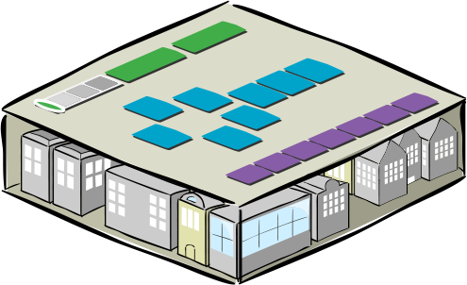
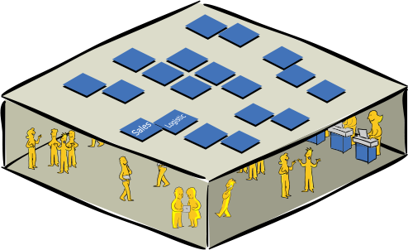
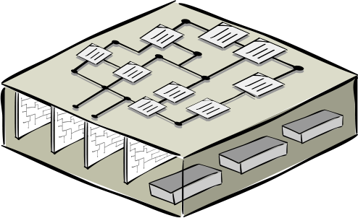
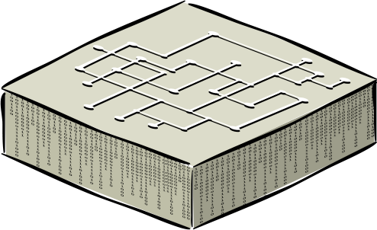
Impact on four dimensions – the POTI model
To understand how the changes will impact IKEA, assessments has and will countinously be made on the POTI dimensions; Process, Organisation, Technology and Information.
Process
Organisation
Technology
Information
Notes:
To get our heads around all the ways switching out our IT systems will affect our jobs, let’s slice our company into four layers.
We call this POTI. In a nutshell, we have to examine what our POTI looks like today, and plan out how it should look in the future.

Slide 19
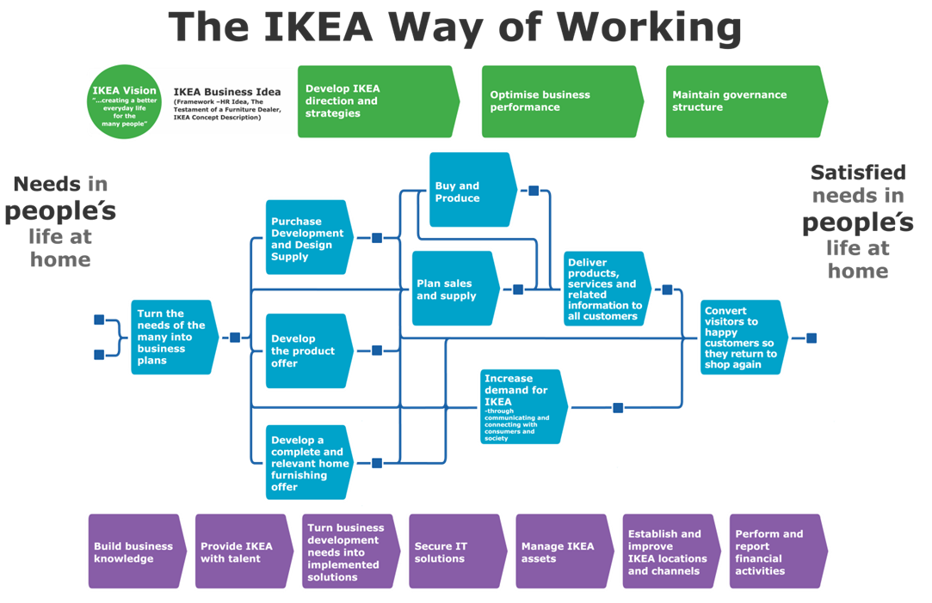
Process impact
MHS functionality has been mapped towards the processes defined by IWOW to understand the overall impact on business. In this view the main process impacted by each functional area of MHS is shown. In coming slide a more detailed mapping is done
Reporting
Store Goods Flow
Sales Order Management & Reservations
Selling
Forecast & safety stock
Cash & Credit Management
Return management
Sales Location Management
Range and Pricing
Tax information & calculation
Financial management
Integrations
Infrastructure

Slide 20
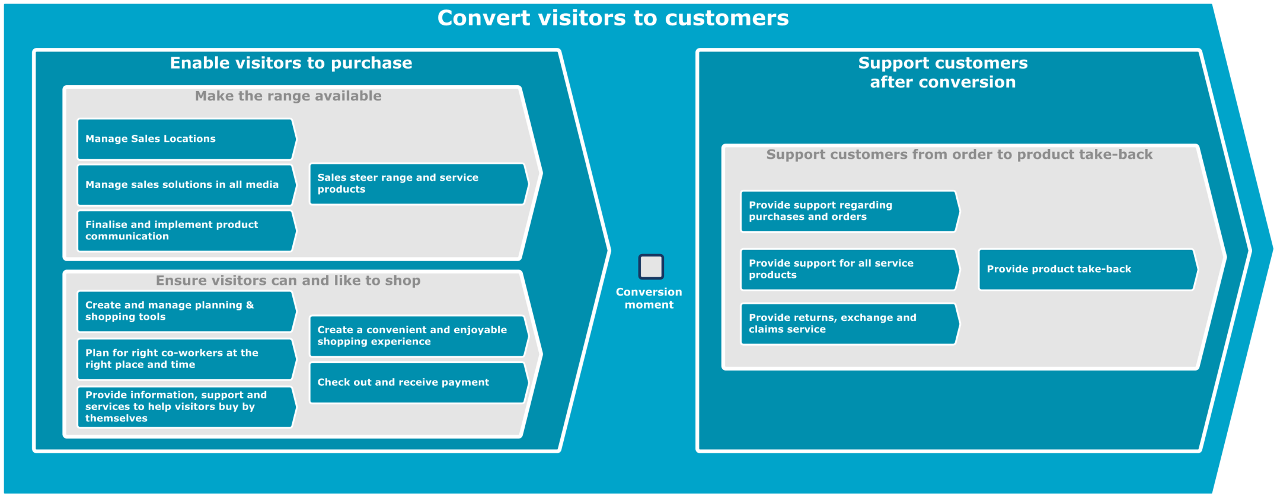

Process Impact
Convert visitors to customers
The purpose of this process is to enable IKEA and our co-workers to have positive meetings with our visitors and customer, inspiring them to regularly shop at IKEA and make them feel think and say: ‘I want to come back and shop again.’, ‘IKEA has something for me.’ , ‘I trust IKEA.’ And ‘It’s worth it.’
SLM
Selling
Selling
SGF - Recovery
Returns management
Cash & Credit Management
Range and Integration

Slide 21
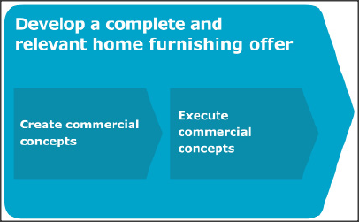
Process Impact
Develop a complete and relevant home furnishing offer
The purpose of this process is to maximize the commercial potential of our total offer, in each market and in the entire Home furnishing context
SLM, Range & Pricing

Slide 22
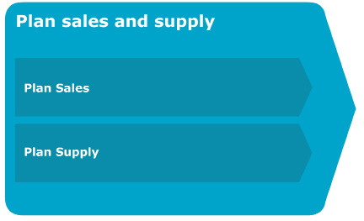
Process Impact
Plan sales and supply
The purpose of this process is xxx
Forecast & Safety Stock
Forecast & Safety Stock

Slide 23
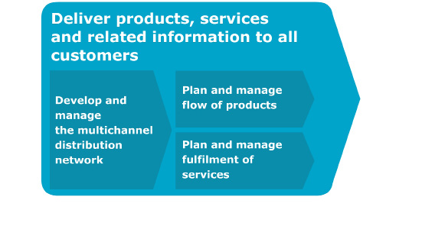
Process Impact
Deliver products, services and related information
The purpose of this process is to secure that all articles from suppliers to customers in all sales channels are both delivered and handled in an efficient way, as well as that all
services are provided in a way that meet customer expectations
SGF, SOM & Selling

Slide 24

Process Impact
Secure IT solutions
The purpose of this process is to effectively and professionally operate, maintain and continuously develop the existing IT landscape so that the IT solutions are available when the business requires.
Integration & Infrastructure

Slide 25

Process Impact
Perform and report financial activities
The purpose of this process is to provide financial information to support judgments and decisions, secure compliance and financial control and secure the financial statements for the IKEA Group
TAX Information and Financial management

Slide 26
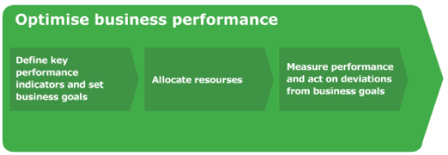
Process Impact
Optimise business performance
The purpose of this process is to break down the goals as formulated in our directions and strategies to define business goals, financial objectives and key performance indicators. It Is also to set resource frames and principles for resource allocation and measure the performance of our business goals.
Reporting
Service level is one of the most important KPIs at IKEA calculated by MHS
Reporting & Financial Management

Slide 27
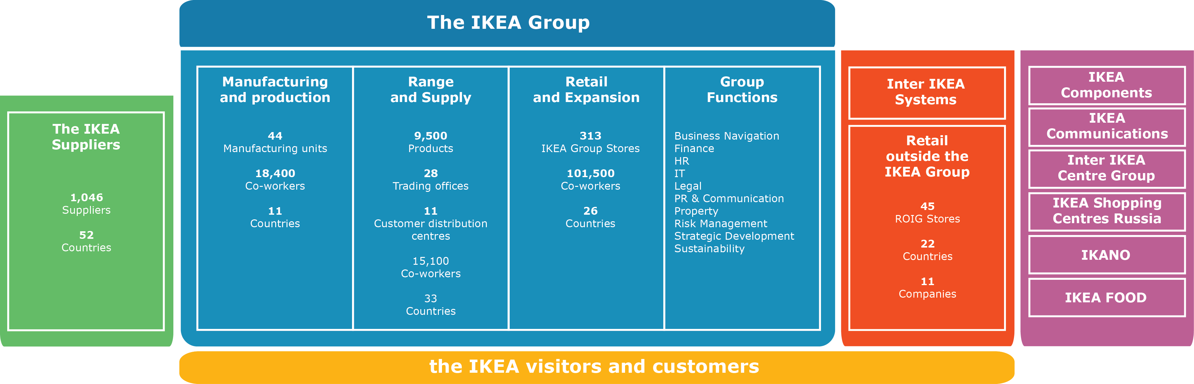
Organizational Impact
MHS Transformation Programme will impact many parts of the organization. Main impact will be in the store and IT and a detailed organization impact analysis will be done in the projects
Organisation impacted by the initiative

Slide 28
Organizational Impact
Retail and Expansion
Stores Store management will be impacted in store performance meassurements, business navigation, human resource and planning perspectives by several or our move out initiatives. Our main impacts in the store will however be on sales department, In Store Logistics and Customer Relations
Country Organization The main impact will be on the stores, but it will result in impact on country organization as well. For example on the areas of Country Manager, Country IT Manager, Demand planners and Finance
IKEA Store
Store Management
Sales department
In Store Logistics
Customer Relations
Communication & Interior design
IKEA Food & Beverages
Cash Office
Notes:
User groups based on http://inside.ikea.com/performance/BusinessNavigation/JapanBusinessNavigationhub/Documents/IKEA%20Store%20BNOM%20Guide.pdf

Slide 29
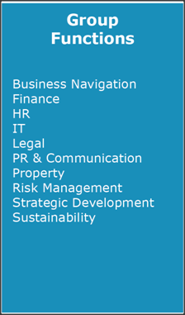
Organizational Impact
Group Functions
Finance Finance activities will have to be done differently then today with possible changes of responsibilities when solutions and source of information will be changed and moved
IT On the IT side there will be impact on support of hardware with new hardware locally and centrally. It will also move responsibilities between the different services while MHS Service will cease to exist

Slide 30
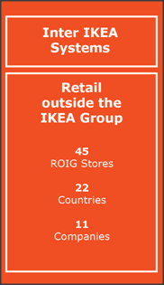
Organizational Impact
Inter IKEA Systems
Inter IKEA Systems Depending on outcome of SGF and SLM there will be impact on Inter IKEA Systems since they are in need of same/similar solutions and are aligning to our work when possible. In the concepts there might also be impact by the big initiatives such as OCR, SGF and SLM.
Retail outside the IKEA Group Delft store is a ROIG store running MHS and will be impacted in same way as any other RIIG store running MHS

Slide 31
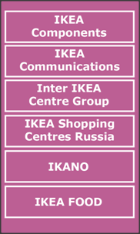
Organizational Impact
IKANO
IKANO
IKANO will be impacted in the early phase of the program when the customer finance and business credit solutions are redesigned and brought out of MHS. This will have a big impact on IKANO in many aspects

Slide 32
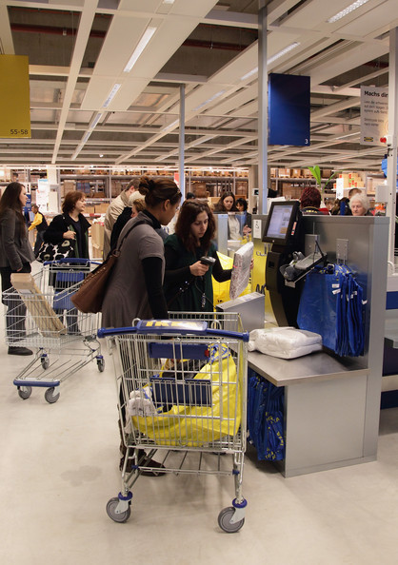
Organizational Impact
The IKEA visitors and customers
Customers and Visitors The direct impact on our customers and visitors will be very limited. The main area where we expect to have direct impact is a possible change of financing and credit options. Indirectly, our customers and visitors will be impacted by - Improvements of availability through forecast and safety stock move outs.
A more seamless shopping experience with move outs aligning the multichannel strategy

Slide 33
Technology Impact
The capabilities supported by MHS today has been mapped to the TL2020 IBCM and the functional areas of MHS as been mapped to the TL2020 platform areas.

Slide 34
Technology Impact
IBCM Mapping
The MHS capability is mapped to the IBCM capability based on that it supports at least some part the IBCM capability.

Slide 35
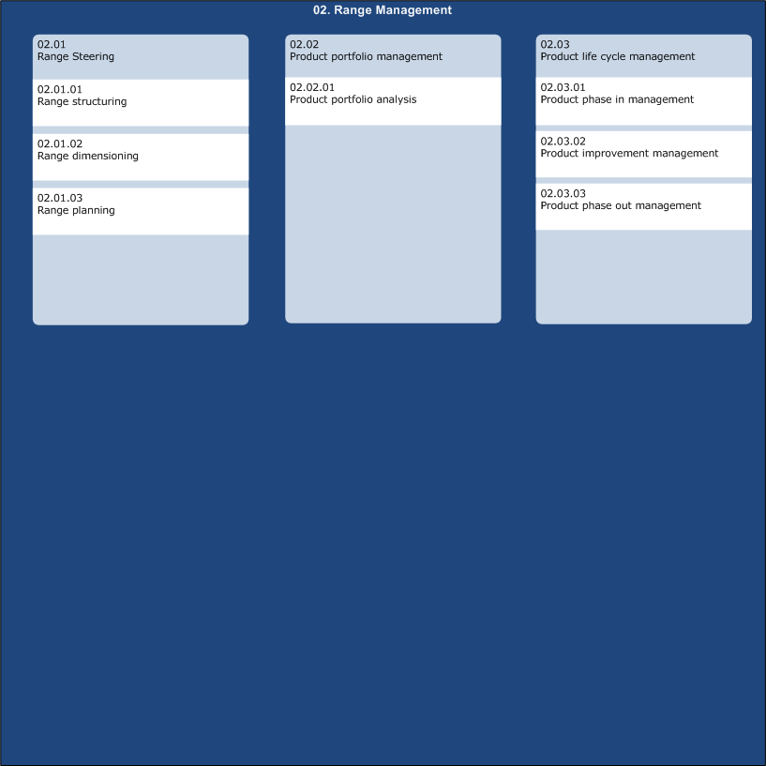
Technology Impact
Range Management
Range
MHS is today owner of the definition of sellable range in store
Range Management

Slide 36
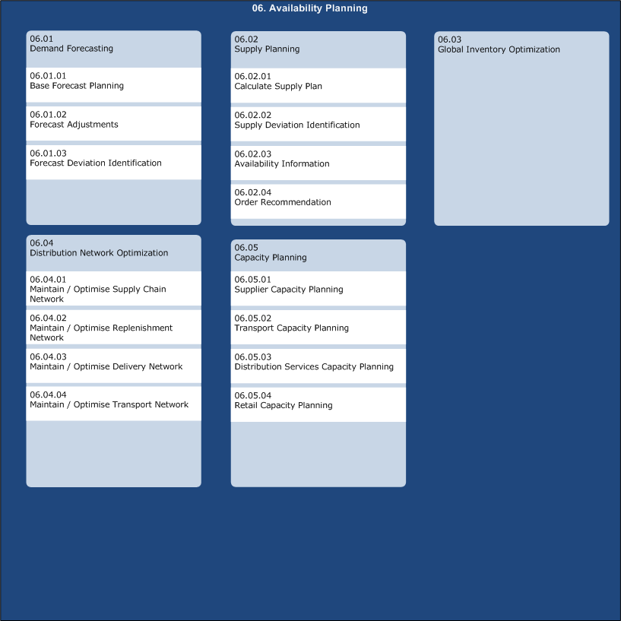
Technology Impact
Availability Planning
Forecast
Forecasting for the stores are fully done in MHS today
Availability planning

Slide 37
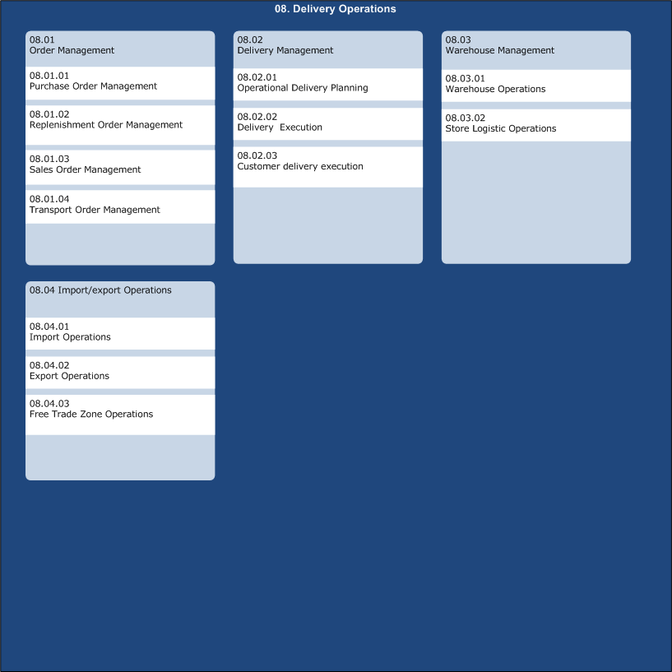
Technology Impact
Delivery Operations
SLO
Store Logistic Operations are fully covered by MHS today
Delivery Operations

Slide 38
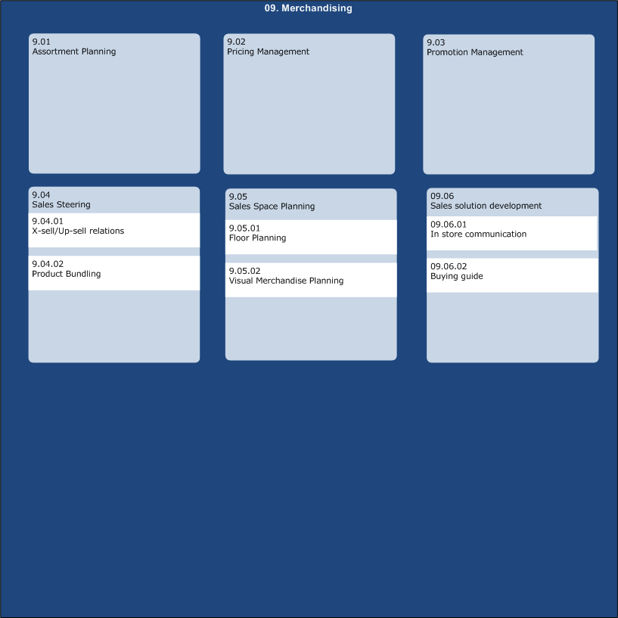
Technology Impact
Merchandising
SLM
Sales location management (floor planning) is fully done by MHS today
Merchandising

Slide 39
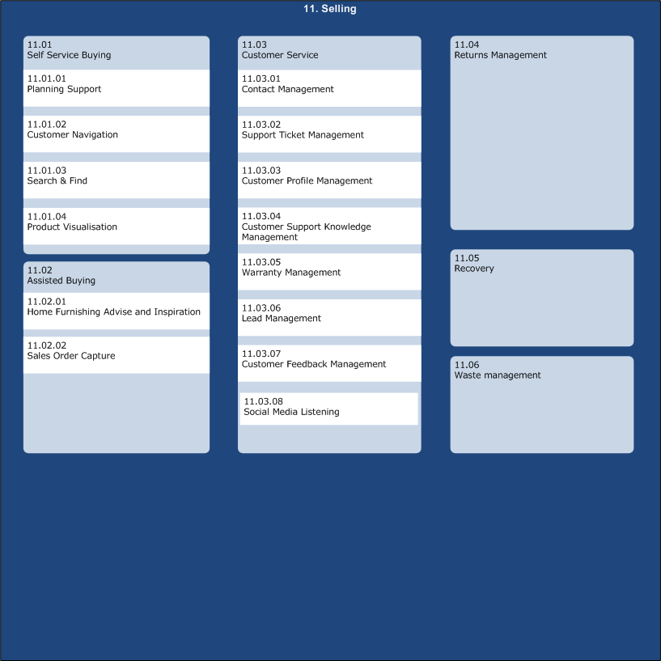
Technology Impact
Selling
Returns & Recovery
Returns & Recovery is fully dependent on MHS Today
Selling

Slide 40
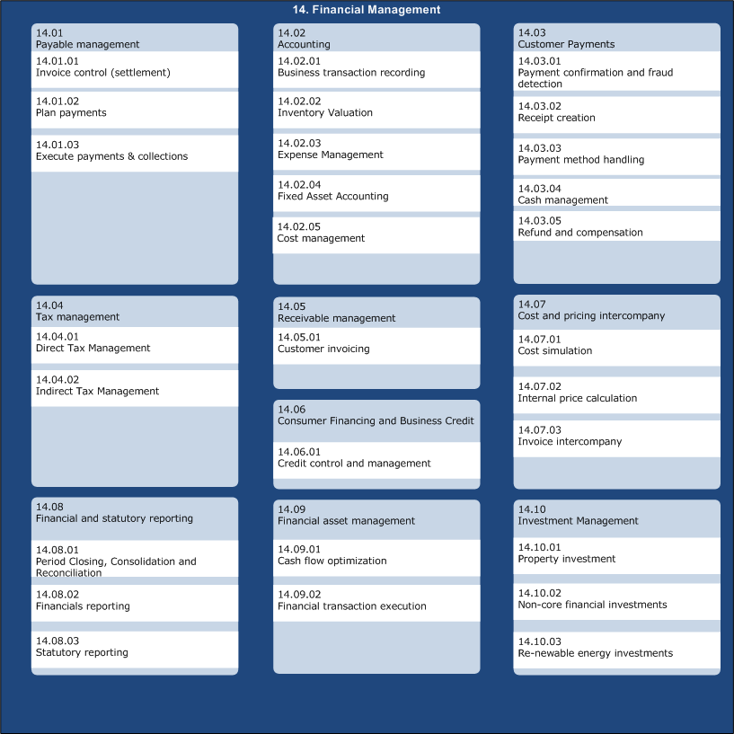
Technology Impact
Financial Management
Financial Mgmt
Many financial flows are dependent on MHS today
Financial Management

Slide 41
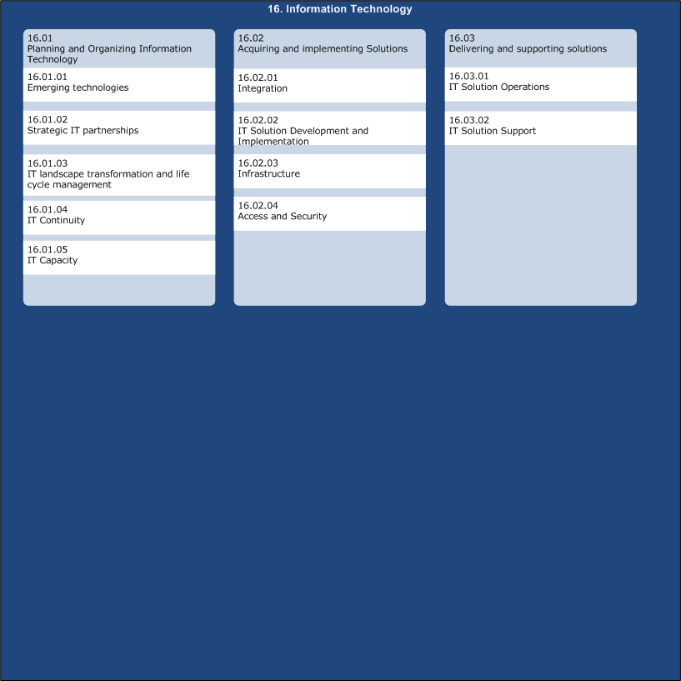
Technology Impact
Information Technology
Integration
MHS is acting as Local Integration Point today with its high availability
Information Technology

Slide 42
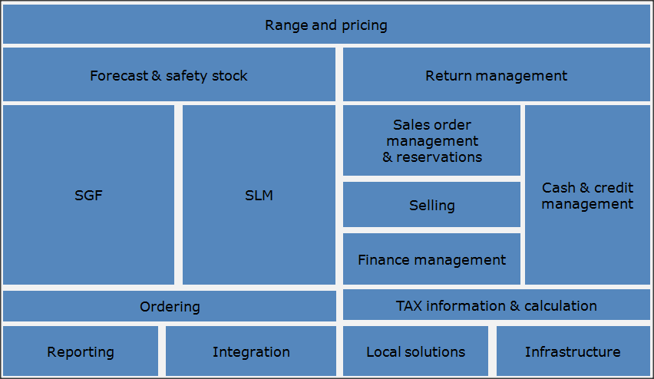
Technology Impact
Platform Areas Mapping
The functional areas of MHS are mapped the Platform areas defined by TL2020
Cash & Credit mgmt
SLM Range & Pricing
Forecast & Safety stock
SGF
Return mgmt Selling
Sales Order Mgmt & Reservations
Finance Mgmt TAX Info & Calculation
Ordering (SGF)
Local Solutions (all areas)
Integration Infrastructure
Reporting

Slide 43
Information Impact
The information in MHS has also been mapped towards TL2020 after doing a thorough analysis of information used and managed in MHS

Slide 44
Information Impact
MHS Information Mapping
Range
Logistics
Sales Planning
Finance
An inventory of all information in MHS has been made to understand the impact and secure that all information objects are covered by the move out projects. In this representation the first two levels of abstraction is presented.
Store range
Storage Locations
Sales Locations
Monetary Sales
Availability
Pallets
Sales space
Quantitative sales
Item base data
Picking order
Departments
Stamp Duty
Price
Stock movements
Areas
TAX
Discounts
Internal orders
Comm Efficiency
Accounting
DWP
Inventory tasks
Order point
Staff purchase
Media
Recovery data
Sales steering info
Purchase price
Suppliers
HFB
Indeliveries
Sales Order
Delivery
Forecast
Payment
Reservations
Consignment
Sales jumps
Credit card
Store Order
Order parameters
Safety Stock
Currency
Zip Codes
Replenishment order
Shortage
Bank deposit
Delivery parameters
Lead time
Activities
Payment code
Supplier matrix
Sales Index
Sales day
Receipt
Blue text: MHS modifies or owns parts of the information objects
People
Property
Selling
Returns
Users
Store info
Sales stops
Return tickets
Visitors & Customers
Service Office
Availability message
Return tenders
Grey text: MHS only consumes the information
Customer info
Sales Department
Loyalty

Slide 45
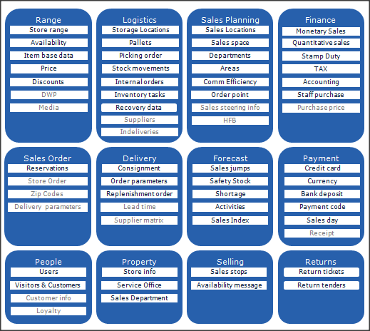
Information Impact
Mapping towards TL2020
The information in MHS has also been mapped towards the main information domains in TL2020. Projects moving information to other solution will have to follow the existing requirements for projects
Logistics, Delivery
Range, Selling, Logistics, Forecast
Payment, Returns
Sales planning, People
People
Finance
Sales Order
Property

Slide 46
ROADMAP
Roadmap Approach An architectural roadmap for each area of MHS with connection to TAL2020

Slide 47
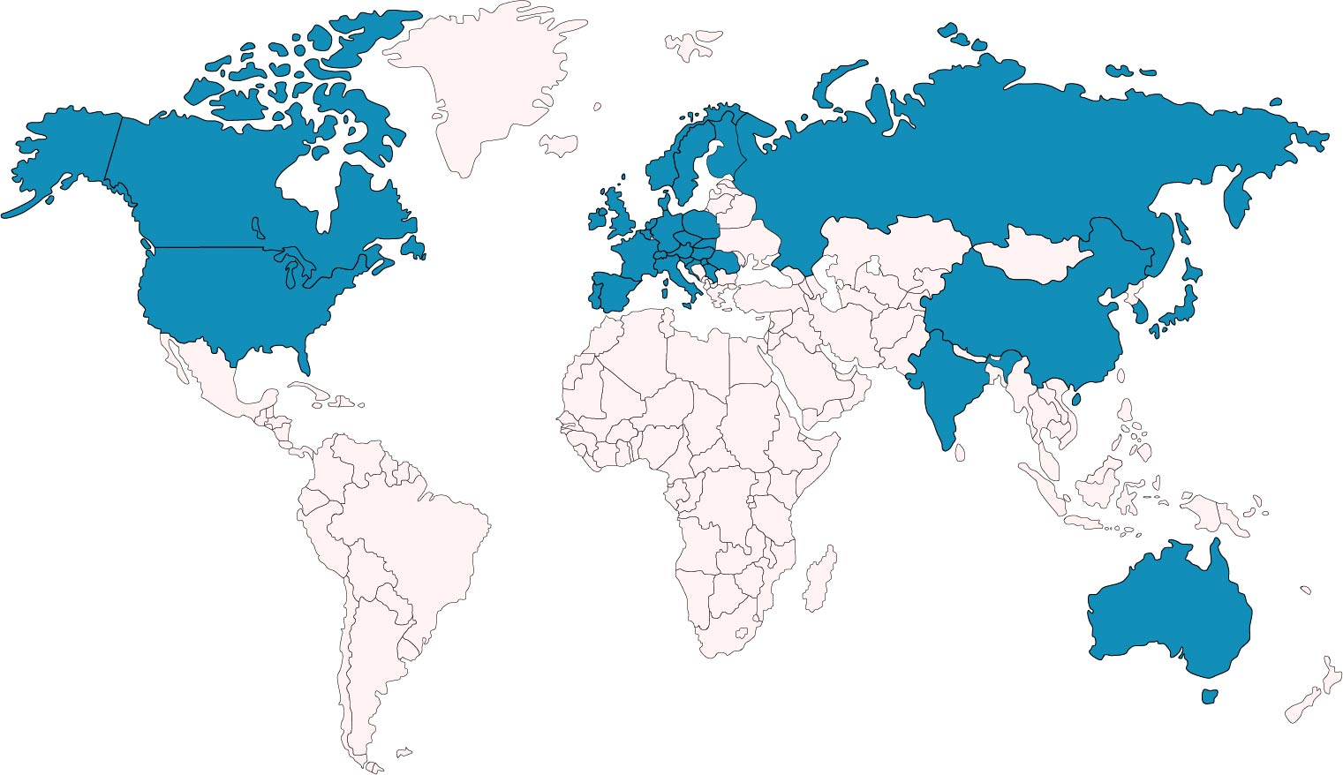
Geographical impact
MHS Transformation programme will impact all retail countries and stores inside the IKEA group (RIIG) as well as the Delft store in several occasions

Slide 48
MHS TP Approach
It is highly recommended to start refactoring the code, before doing any type of migration -Brett Cameron, HP
With the history and learnings from many previous attempts to move out of MHS, it is decided to decommission MHS in form of a programme to secure that the scope and roadmap of move out projects will take us out of MHS in time. The programmes recipe for success is to ’cut the cheese’ instead of trying to find a platform that can replace MHS 1-to-1. We must enable this disassembly of MHS by removing functionality, information, integrations and user interfaces from MHS piece by piece. This is to reduce complexity from MHS and not take it as one big chunk and not leaving code that needs to be considered in all following move outs. One of the main planning principles agreed in the programme is to always clean up MHS TP to a minimum to reduce complexity and dependencies!
In the spring 2014 we had a workshop with HP to get their recommendations on approach and they adressed two important parts based on their experience of other customer in similar situations. HPs recomendation was: Don’t underestimate testing effort and start with cleanup and refactoring early to minimize complexity and dependencies in the programme!
By mapping everything in MHS (capabilities, information, reports, screens, etc) towards move out projects, MHS TP will be able to secure that move out projects are scoped to reach MHS TP needs. It is also for the programme to minimize the risk of having things ’falling between the chairs’.
Move out of MHS non core functionality
Move out of MHS core functionality
Close down of MHS
Cleanup & Refactor

Slide 49
Programme targets
We will transfer all business needs in MHS. The main areas to transfer out of MHS has been identified.
Range and pricing
Forecast & safety stock
Return management
SGF
SLM
Sales order management & reservations
Cash & credit management
Selling
Finance management
Ordering
TAX information & calculation
Reporting
Integration
Local solutions
Infrastructure
MHS Logic planned to be moved to target
MHS Logic to be moved to intermediate solution
Moved out by dependency projects
To be further investigated

Slide 50
Range & Pricing
Pricing will be moved to short term solution with integration placed in target, range is to be defined in coming prestudy.
MHS TP
Pricing
Prestudy performed together with multichannel pricing that considers MHS time restrictions
Pricing management to be moved out of MHS
Range
Range life cycle control to be moved out of MHS. Prestudy to be done to define how and where to implement it
TL2020 Alignment
Pricing
Move out to short term solution to minimize multichannel pricing dependency to MHS
Pricing positioned together with other pricing management.
Integration to be implemented according to target design
Range
Prestudy should align with target architecture
Range and pricing
Forecast & safety stock
Return management
SGF
SLM
Sales order management & reservations
Cash & credit management
Selling
Finance management
Ordering
TAX information & calculation
Reporting
Integration
Local solutions
Infrastructure
Dependent on
Multichannel Pricing Management
IKEA for Food
Integration concept

Slide 51
Forecast & Safety stock
To be moved out directly to target solution through a dependency project
MHS TP
Forecast & Safety Stock
Start project to move forecast and safety stock calculations to JDA in alignment with previously done prestudies
Service Level
Needs to be moved out together with ???? which performs shortage calculation
TL2020 Alignment
Forecast & Safety Stock
JDA is the target which we aim to move out to directly
Service Level
xxxxxx
Range and pricing
Forecast & safety stock
Return management
SGF
SLM
Sales order management & reservations
Cash & credit management
Selling
Finance management
Ordering
TAX information & calculation
Reporting
Integration
Local solutions
Infrastructure
Dependent on
SGF and SLM prestudies
Integration concept

Slide 52
Returns Management
Start with refactoring to give possibility to move out to target in a dependency project.
MHS TP
Returns
Start project to refactor returns inside MHS to simplify a move out and give more time until we must have reached a target or start a Plan B.
CRM to move out to target as a dependency project/programme
TL2020 Alignment
Returns
Oracle is the target for CRM (Case and return handlign) and assumed target for return object is IBM Sales Orders.
MHS will enable an easier move out to target by refactoring and prolong the time span for doing this.
Range and pricing
Forecast & safety stock
Return management
SGF
SLM
Sales order management & reservations
Cash & credit management
Selling
Finance management
Ordering
TAX information & calculation
Reporting
Integration
Local solutions
Infrastructure
Dependent on
Multichannel Returns Management
Case Management
Integration concept

Slide 53
Store Goods Flow
Prestudy is defining target for SGF functionality and how to get there. MHS TP to order project according to prestudy outcome
MHS TP
Store Goods Flow
Prestudy ongoing to define target for SGF which is the Store Logistic Operations platform area. The prestudy will present a roadmap that is aligned with MHS TP roadmap.
MHS TP to initiate project according to prestudy outcomed
TL2020 Alignment
Store Logistic Operations
Prestudy to define target and MHS TP will follow those directions .
Range and pricing
Forecast & safety stock
Return management
SGF
SLM
Sales order management & reservations
Cash & credit management
Selling
Finance management
Ordering
TAX information & calculation
Reporting
Integration
Local solutions
Infrastructure
Dependent on
Multichannel Logistic Setup for Stores
Dimension and Weight Packaging
Sales Location Management
Integration concept

Slide 54
Sales Location Management
Prestudy is defining target for SLM functionality and how to get there. MHS TP to order project according to prestudy outcome
MHS TP
Sales Location Management
Prestudy ongoing to define target for Sales Location Management which is in the platform area Merchandising. The prestudy will present a roadmap that is aligned with MHS TP roadmap.
MHS TP to initiate project according to prestudy outcomed
TL2020 Alignment
Sales Location Management
Prestudy to define target and MHS TP will follow those directions .
Range and pricing
Forecast & safety stock
Return management
SGF
SLM
Sales order management & reservations
Cash & credit management
Selling
Finance management
Ordering
TAX information & calculation
Reporting
Integration
Local solutions
Infrastructure
Dependent on
Multichannel Logistic Setup for Stores
One Common Replenishment
Store Goods Flow
Integration concept

Slide 55
Sales Order Management & Reservations
Sales Order Management is already being implemented with eCommerce and we will have them as dependency project
MHS TP
Sales Order Management
We are expecting eCommerce to remove Sales Orders with connected logic from MHS. Already before, refactoring activities will take place to only have MHS involved in orders fulfilled in Store
Reservations
The reservations handled in MHS today is hard reservation that we will move out together with SGF which has the physical stock. Soft reservations is positioned to be handled by ISOM
TL2020 Alignment
Sales Order Management
eCommerce project ISOM to move implement new sales order in target solution
Reservations
ISOM is a target solution for solf reservations. For hard reservations, see Store Goods Flow
Range and pricing
Forecast & safety stock
Return management
SGF
SLM
Sales order management & reservations
Cash & credit management
Selling
Finance management
Ordering
TAX information & calculation
Reporting
Integration
Local solutions
Infrastructure
Dependent on
ISOM
Store Goods Flow
Integration concept

Slide 56
Selling
Main functionality will land in ISOM/iSell and the dependency project Quality Deviation Project will position sales stops in a target solution.
MHS TP
Customer Order Management
Cleanup of old customer order logic and selling screens when Centiro and PinS is fully rolled out
Sales stops
The reservations handled in MHS today is hard reservation that we will move out together with SGF which has the physical stock. Soft reservations is positioned to be handled by ISOM
TL2020 Alignment
Customer Order Management
Already existing in iSell and ISOM. It is about closing down equivalent functionality in MHS
Sales stops
Quality Deviation Project will drive this move out to target
Range and pricing
Forecast & safety stock
Return management
SGF
SLM
Sales order management & reservations
Cash & credit management
Selling
Finance management
Ordering
TAX information & calculation
Reporting
Integration
Local solutions
Infrastructure
Dependent on
ISOM
Quality Deviation Project
Picking In Store
Centiro Rollout
Integration concept

Slide 57
Finance Management
Functionality in this area will be moved to target by dependency projects, but close down will have to be done by MHS TP in several cases
MHS TP
Business Accounting
SAREC+ is implementing target solution for this, MHS TP will need TO remove it from MHS with receipt object as main focus
Sales follow up
Sales statistics to be aggregated in BI solutions, operational statistics to be found in mainly IPOS and ISOM
TAX Handling
Definition and integration of TAX/VAT to be moved out according to prestudy
Prepayment to be solved by eCommerce
TL2020 Alignment
Business Accounting
SAREC+ in cooperation is IPOS (Wincor) is target which we aim to reach
Sales follow up
IPOS, ISOM and FBIL are all target solutions and is where we plan to land most of this follow up
TAX Handling
Use CBD/TIM for Tax rates and move integrations to LIP as target solutions
MHS will not be involved in pre-payment when ISOM handles all orders
Range and pricing
Forecast & safety stock
Return management
SGF
SLM
Sales order management & reservations
Cash & credit management
Selling
Finance management
Ordering
TAX information & calculation
Reporting
Integration
Local solutions
Infrastructure
Dependent on
IPOS
SAREC+
Integration concept
ISOM
TIM

Slide 58
Cash & Credit Management
Functionality this area will be moved to target solutions by dependency projects and MHS TP Projects.
MHS TP
Cash Management
iPOS will take all Cash Management from MHS
Close down to be done separately
Receipt handling to be removed in coordination with finance mgmt
Business Credit
MHS will be disconnected from all business credit flows after eCommerce alignment has been secured
Customer Financing
New target for customer financing to be defined and implemented
TL2020 Alignment
Cash Management
Positioned in IPOS which is target for this area
Business Credit
Moves integrations out to integration platform
Customer Financing
Investigating possibility to provide this as external service as a target solution.
Range and pricing
Forecast & safety stock
Return management
SGF
SLM
Sales order management & reservations
Cash & credit management
Selling
Finance management
Ordering
TAX information & calculation
Reporting
Integration
Local solutions
Infrastructure
Dependent on
IKANO
IPOS
LIP

Slide 59
Ordering
Start with refactoring to give possibility to move out to target in a dependency project.
MHS TP
Order Calculation
Start project to refactor returns inside MHS to simplify a move out and give more time until we must have reached a target or start a Plan B.
???? to move out to target as a dependency project/programme
Manual Orders
Goes together with order calculation
TL2020 Alignment
Order Calculation
New order engine is to implement into target.
MHS will enable an easier move out to target by refactoring and prolong the time span for doing this.
Manual Orders
Same as order calculation
Range and pricing
Forecast & safety stock
Return management
SGF
SLM
Sales order management & reservations
Cash & credit management
Selling
Finance management
Ordering
TAX information & calculation
Reporting
Integration
Local solutions
Infrastructure
Dependent on
Order engine

Slide 60
TAX Information & Calculation
The initiatives will take us to the wished positions for the areas covered by MHS and move out of functionality is to existing targets.
MHS TP
Pre-payment Handling
Remove MHS role in tax and sales reporting around pre payment item (sales group 87).
Static Retail Tax
Initiative to be started based on outcome of prestudy. Use centrally governed TAX data and stop integrating Static TAX information
TL2020 Alignment
Pre-payment Handling
Aligned to wanted position for this area, this is a flow and not pointing at a specific target appliation. Main solutions in new flow are IPOS, LIP, FBIL, iSell and ISOM
Static Retail Tax
Use CBD/TIM as single source of information which is the target solution defined in pre study
Range and pricing
Forecast & safety stock
Return management
SGF
SLM
Sales order management & reservations
Cash & credit management
Selling
Finance management
Ordering
TAX information & calculation
Reporting
Integration
Local solutions
Infrastructure
Dependent on
ISOM
IPOS
LIP

Slide 61
Reporting
The approach of reporting is to let the move out projects take responsibility to close down and replace reports from MHS.
MHS TP
General
Cleanup and consolidation of reports will be done initially
To simplify for coming projects a tactical move and consolidation of reports to GADD will be done.
Each report left will be mapped to a move out project that will have responsibility to close them down (replaced by reports, GUIs & working methods in new solution)
TL2020 Alignment
General
First step is purely tactical and will simplify the landscape slightly but MHS a lot!
Final position is to have operational reports handled in each solution and strategic reporting in FBIL
Range and pricing
Forecast & safety stock
Return management
SGF
SLM
Sales order management & reservations
Cash & credit management
Selling
Finance management
Ordering
TAX information & calculation
Reporting
Integration
Local solutions
Infrastructure
Dependent on
FBIL

Slide 62
Integration
Integrations will play a central role in the Transformation of MHS and the integration concept will be used
MHS TP
Local Integration
We need to establish a Local Integration Platform and develop the integration concept to meet the needs when transforming MHS.
Central Integration
All integrations moves will be aligned with the integration concept. Integration in general will be a key success factor for MHS TP
TL2020 Alignment
Local Integration
Establish the LIP according to the integration concept and target architecture
Central Integration
Using the already established central integration platform when moving integrations.
Range and pricing
Forecast & safety stock
Return management
SGF
SLM
Sales order management & reservations
Cash & credit management
Selling
Finance management
Ordering
TAX information & calculation
Reporting
Integration
Local solutions
Infrastructure
Dependent on
LIP
IIP

Slide 63
Local Solutions
xxx
MHS TP
Order Calculation
xxxx
Manual Orders
Mxxxx
TL2020 Alignment
Order Calculation
xxx
Manual Orders
xxx
Range and pricing
Forecast & safety stock
Return management
SGF
SLM
Sales order management & reservations
Cash & credit management
Selling
Finance management
Ordering
TAX information & calculation
Reporting
Integration
Local solutions
Infrastructure
Dependent on
xxx
xxx

Slide 64
Infrastructure
xxx
MHS TP
Local infrastructure
LIP, close down of hardware, new solutions in store?
Backups
Plan for handling of old MHS backups is needed to meet legal demands of archiving
Access and Security
The new solutions should provide access and security based on CDS
TL2020 Alignment
Order Calculation
xxx
Access and Security
No impact on TL2020
Range and pricing
Forecast & safety stock
Return management
SGF
SLM
Sales order management & reservations
Cash & credit management
Selling
Finance management
Ordering
TAX information & calculation
Reporting
Integration
Local solutions
Infrastructure
Dependent on
xxx
xxx

Slide 65
Integration and Infrastructure
Includes Integration, Infrastructure and Access and Security
MHS TP
Integration
To move out MHS role as local integration point a Local Integration Platorm with high availability and performance needs to be established
Infrastructure
Close down of hardware project will be needed
Secure backups initiative is needed to meet legal demands of archiving
Access and Security
The new solutions should provide access and security based on CDS
TAL2020
Integration
According to integration concept
Infrastructure
n/a
Access and Security
No impact on TAL2020
Dependent on
Integration
Many initiatives will b e dependent on this one to not build in new integrations towards MHS
Infrastructure
Everthing being moved out of MHS
Access and Security
Nothing

Slide 66

High level time plan
Wondering when your part of MHS is changing? Here’s a general overview of the coming
years’ major milestones.
FY15
FY16
FY17
FY18
FY19
FY20+
Refactoring
SLM & SGF targets defined
Initial cleanup
Proof of concept
Refactoring
Customer order moved out
Pricing management moved out
Tax info & Calc. moved out Business Credit moved out Customer financing moved out Local integration platform established
Refactoring
Forecast & Safety stock moved out
Range management moved out
Cash management removed
Refactoring
Integrations
moved out
Receipt management moved out
Sales statistics moved out
Returns management moved out
Replenishment ordering moved out Sales Order Management moved out
SLM moved out
SGF moved out
Picking service moved out
Close down of MHS

Slide 67
Current Roadmap
FY15
FY16
FY17
Payments & Returns
POS Upgrade Rollout
Close Cash Management
Prestudy
Receipt Management
Rollout
SAREC+ Rollout
Prestudy
Credit Management
Rollout
Multichannel Returns Management
Cleanup
After Sales Prestudy
Prestudy
New Support Ticket Mgmt Solution
Finance & Reporting
FBIL
Secure Reporting
Tax Intelligence Module / VAT4eCom
TAX Information & Calculation
Rollout+Cleanup
Sales Orders
PinS Rollout
Remove Cust Order Mgmt
Rollout
Centiro Rollout
SOM
Cleanup
eCom Global rollout project
Range & Price
Prestudy
Pricing Mgmt
Prestudy
Store Range Mgmt
PTAG Prestudy
Replace PTAG
SLM
New Available to Customer
SLM&SGF Prestudy
Shortage Calc Prestudy
SLM Move out
SCP
One Common Replenishment
Traceability
STMS
Store Logistics
DWP Next Generation
Cleanup
Quality Deviation Project
Cleanup
TO BE RECREATED
Future Logistic In Store
Multichannel Logistic set up for stores
SGF Move out project
SLM&SGF Prestudy
Cleanup of MHS
Local integration platform
Prestudy
Remove system dependencies
Core & IT
PoC Plan B
Standardize and prepare code
Learning Management Setup
Access Solutions Prestudy
Secure Local solutions
Release&Test management
Q1 Q2 Q3 Q4 Q1 Q2 Q3 Q4 Q1 Q2 Q3 Q4
MHS TP Projects
Dependency Projects
Impacting Projects

Slide 68


We need to ensure that we
have the co-worker and the customer in focus
move towards a multichannel environment
are cost conscious with time as first priority
MHS TRANSFORMATION PROGRAMME

Slide 69
Contact us
Please contact us if you have any questions regarding the Programme!
Steve Dunnico, Programme Manager
steve.dunnico3@ikea.com
Emil Nilsson, Programme Business Architect
emil.nilsson3@ikea.com
Christer Svensson, Programme IT Architect
external.christer.svensson3@ikea.com

